Slide 1

RRHH-system
Course: Base de Datos ICIFF004
Workshop 2
Simplifying HR Management, One Click at a Time
by
Alan Silva, Dante Quezada and Lucas Brown
Professor in charge: Cristhian Aguilera
November 29th, 2024

Slide 2

What is HR?
This department manages:
Employees
Contracts
Remuneration
Training
Evaluations
Vacations
Health Plans, Pension Funds
Human Resources (HR) plays a pivotal role in managing an organization’s most valuable asset: its people.
2/11

Slide 3

Challenges HR faces:
Manual processes – All information is managed via time-consuming tasks for registering contracts, defining employees, etc.
Inefficiencies - Lack of a defined structure to so store and relate data on the company.
Human errors – Mistakes in calculations, saving the data, deleting vital information the government would need.
3/11

Slide 4
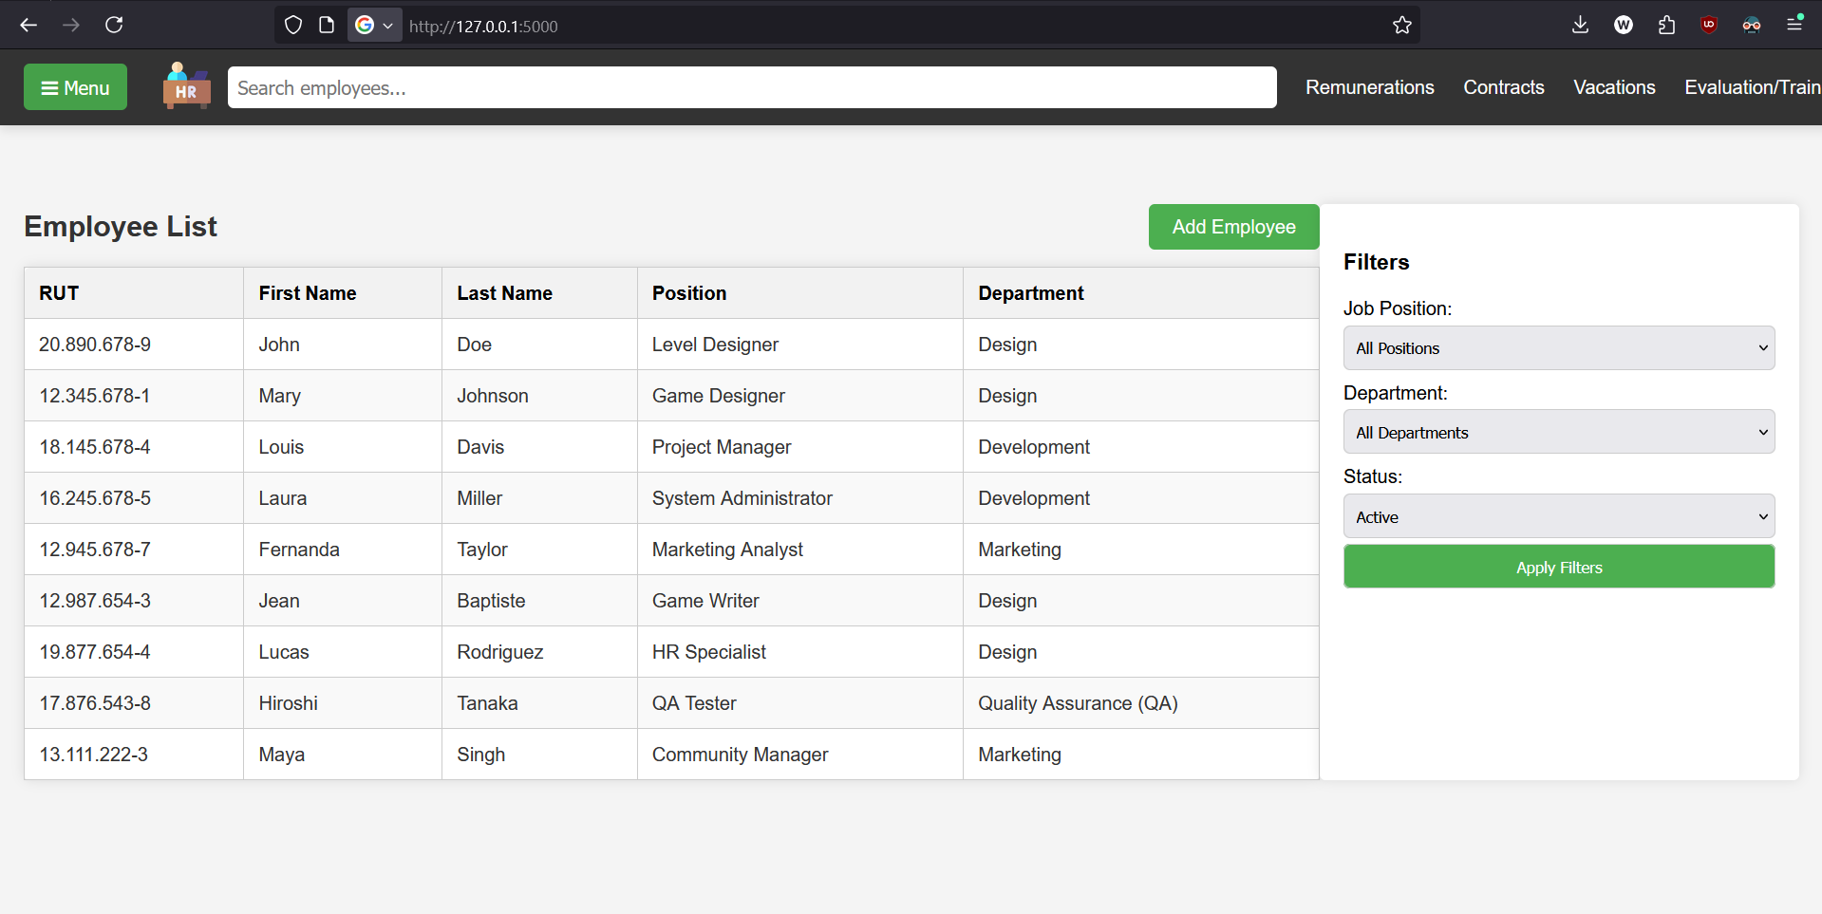
Solution
http://172.214.209.5:5000/
(imposed by this course)
4/11

Slide 5
(HERE WE SHOW THE WEBAPP)
5/11

Slide 6








Key Technologies
6/11

Slide 7
Python is the primary programming language used for developing this application. Known for its simplicity and versatility, it enables rapid development and seamless integration with various tools and libraries.
Flask is a lightweight web framework for Python. It is used to handle routing, manage HTTP requests, and render HTML templates, making it ideal for building scalable and dynamic web applications.
SQLAlchemy is an Object-Relational Mapping (ORM) library for Python. It simplifies database interactions by allowing us to work with Python objects instead of raw SQL queries, ensuring efficient and readable database management.
7/11

Slide 8

MySQL is the database used in this project to store all the HR-related data, such as employee records and vacation details. It allows the application to easily retrieve and store information in a structured way.
Docker is used in this project to make sure that the application runs the same way on every machine and helps to connect the application to the MySQL database securely and reliably by managing the necessary ports and network settings. Docker helps ensure the MySQL version used by all team members is the same, making the development process smoother and avoiding compatibility issues.
8/11

Slide 9

HTML is the foundation of any webpage. It defines the structure and content of the page, such as headings, paragraphs, images, and links. In other words, HTML gives the page its basic framework.
CSS is used to style the HTML content, giving it a visually appealing layout, colors, fonts, and other design elements. It controls the appearance of the page, like the spacing, borders, and alignment. Without CSS, the page would just be plain, unstyled content.
JavaScript is used to add interactivity to the webpage. It allows for actions like responding to user input (clicks, form submissions), updating the content dynamically without refreshing the page, or handling events like showing a pop-up.
9/11

Slide 10
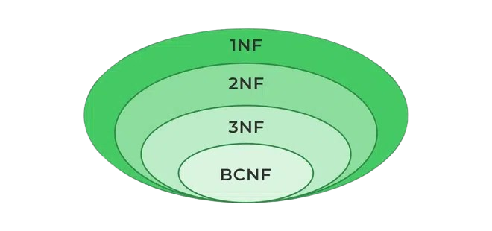


Issues we encountered in the process
Normal form problems within the database.
Lack of coordination while working.
Huge merge conflicts while working with GitHub.
Could have done things differently but was too late to retrace our steps.
10/11

Slide 11


What we gathered from the project
Introduced ourselves to Docker and Azure.
Learned how HTML, CSS and JS work together.
Gained a clear understanding of what to expect in the context of web apps with database integrations.
Reinforced our relational databases knowledge.
11/11

